Slide 1
HEART FAILURE PREDICTION APP
Topic No: 3

Slide 2
Introduction
Heart failure (HF) is a condition that occurs when the heart is unable to pump enough blood to the body, and it is usually caused by chronic conditions such as coronary heart disease, high blood pressure, or other heart conditions or diseases

Slide 3
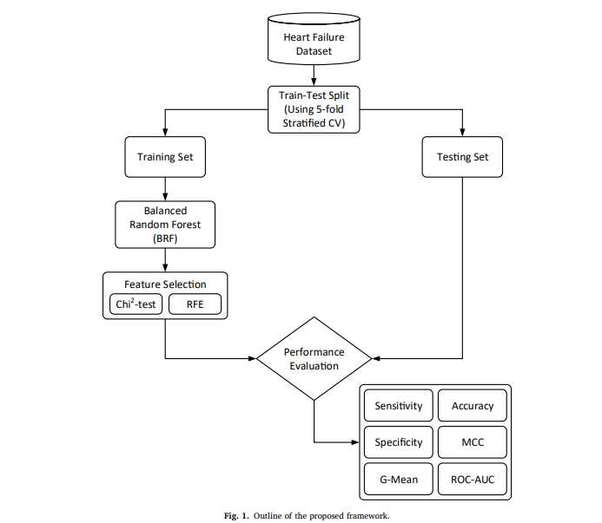
MODEL
Metrics Used: F1 score with a higher recall score and considerable precision score as the evaluation metrics. Model training: Created various models like:
Logistic Classifier
Decision Tree Classifier
Random Forest Classification Model
LGBM
XGB
and other classification models and fitted the train data to each model.

Slide 4


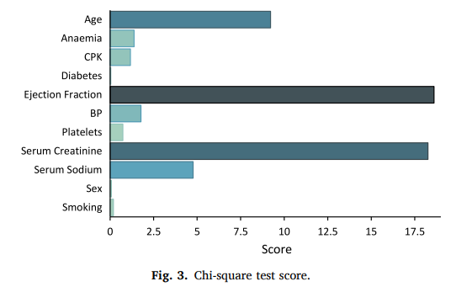
Testing
What input data is required?
The model takes 12 variables as input:
Age
Anaemia
Creatinine Phosphokinase
Diabetes
Ejection Fraction
High Blood Pressure
Platelets
Serum Creatinine
Serum Sodium
Sex
Smoking
Follow Up Time in Hospital

